Slide 1


Securing web applications using Azure AD
Damien Bowden
https://damienbod.com

Slide 2
Security focus of this talk
Authentication and Authorization
HTTPS Certificates TLS 1.2, 1.3
GDPR, Data breaches
Hosting
Infrastructure security
Session Protection, HTTP headers
Accounting, MFA and IAM
Security governance

Slide 3
Applications with users
Applications with no user
Secure APIs
Azure continuous access evaluation

Slide 4
Modern security uses Zero Trust
Zero Trust is a security strategy.
Verify explicitly (Never trust, always verify)
Least privilege (Blast radius)
Assume breach
Continuous evaluation
Notes:
Explicit verification and continuous validation: Network users must be authenticated, authorized, and validated on an ongoing basis to ensure they always have the proper permissions. Numerous data points such as user identity, geolocation, and device posture may be leveraged for this purpose. One-time validation of a user identity is no longer enough.
Least-privileged access: Zero trust reduces a company’s attack surface by enforcing the principle of least privilege, so that identities only get the lowest level of access to the network by default. In tandem with other cybersecurity practices such as network micro-segmentation and adaptive access, least-privileged access sharply limits lateral movement within a zero trust model.

Slide 5

The old way…

Slide 6
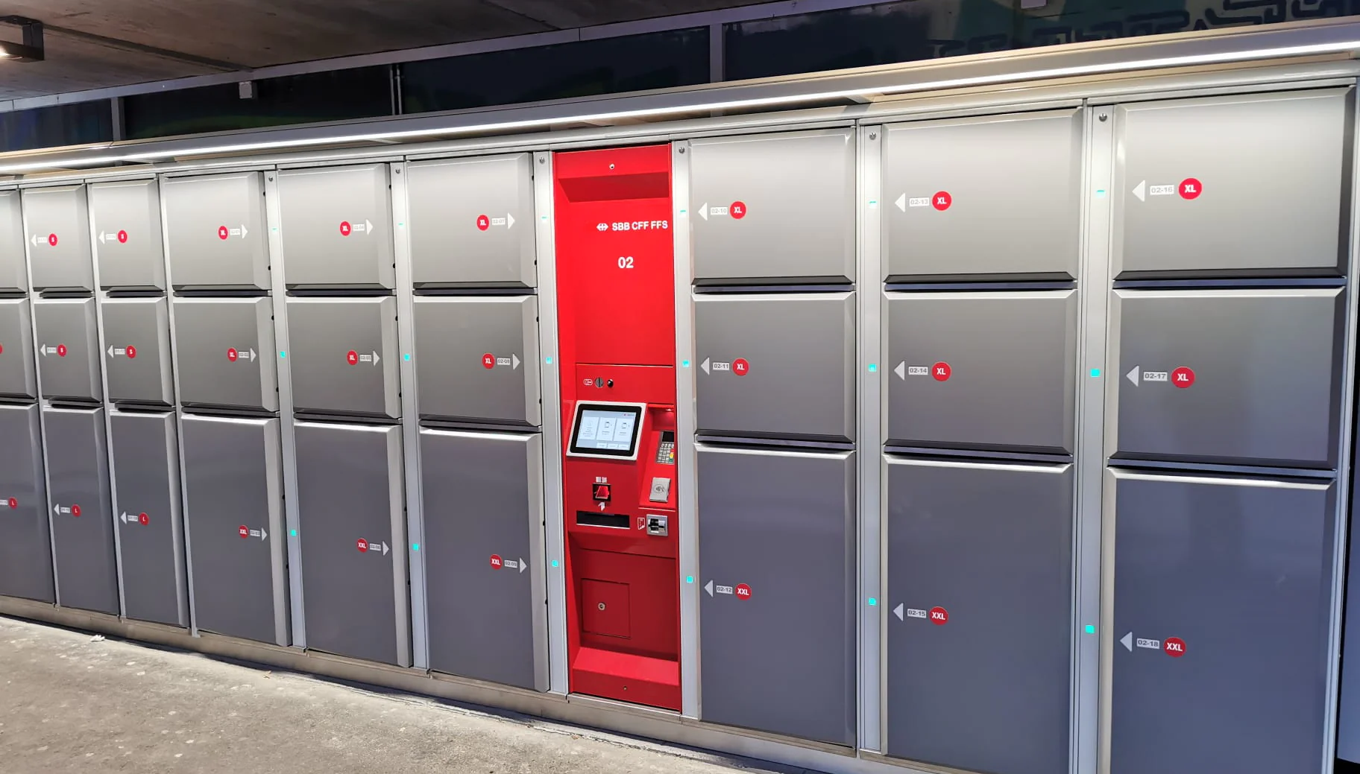
Authentication is the new boundary
Notes:
New pic to explain zero trust

Slide 7
Identity and service principals
User identities?
Internal and external users
Workload identities?
In Microsoft Entra, workload identities are applications, service principals, and managed identities.
Device identities?
Device identities represent devices such as desktop computers, mobile, IoT sensors, and IoT managed devices.
Notes:
https://learn.microsoft.com/en-us/azure/active-directory/workload-identities/workload-identities-overview

Slide 8
Identity and service principals
We authenticate identities!
Human identities
user + application is authenticated
Machine identities
Service principal, application, managed identity or device is authenticated

Slide 9
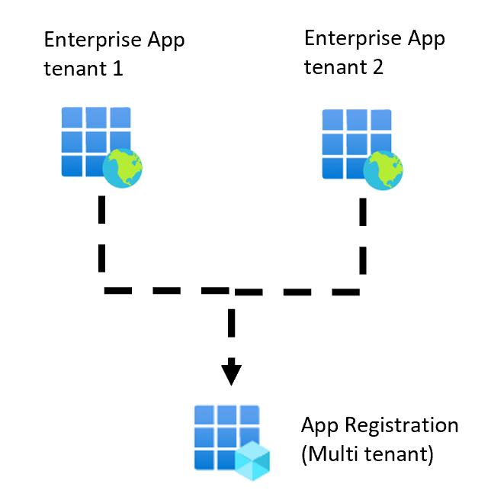
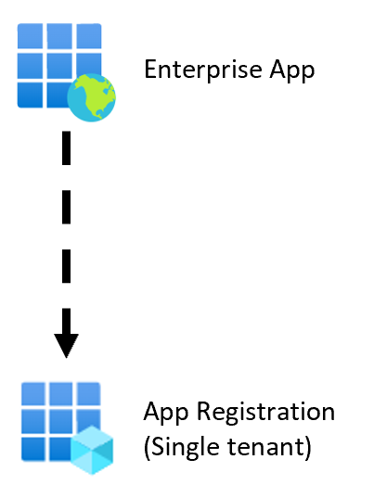
Multi/single tenant applications

Slide 10
Azure App registrations
Never mix application permissions and delegated permissions in a single Azure App registration

Slide 11
Azure App registrations
Require a secret, certificate or service managed identity when using admin permissions
Notes:
Never user managed identities

Slide 12
Azure Enterprise applications
Avoid multi-tenant Enterprise applications unless required. Grant consent with extreme caution!

Slide 13
Typical user session
Authorization
Authentication
Session
Signout

Slide 14
USE Standards
Don’t implement this yourself, use certified libs, packages, tested

Slide 15



Slide 16
OpenID Connect
Authentication
OAuth2
Delegated
Authorization

Slide 17
OpenID Connect
Standard, Specification
Authentication and Authorization
built on top of OAuth2 (access control)
Identity (Person can have n Identities)
UserInfo Endpoint
http://openid.net/connect/

Slide 18
Open ID Connect (OIDC) is supported by almost all systems.
Azure AD, Auth0, OKTA, IdentityServer4, google accounts, Openiddict, node-oidc-provider, Azure B2C

Slide 19
Typical user session
Authorization
Authentication
Session
Signout

Slide 20

Authentication with users
Notes:
Explain one stop apps, reusing company AAA

Slide 21
OpenID Connect Flows in Azure OAuth2 Flows with users http://openid.net/specs/openid-connect-core-1_0.html
OpenID Connect Code flow + PKCE with client secret
OpenID Connect Code flow + PKCE with no secret
OAuth Device Flow
OpenID Connect Hybrid flow
Notes:
15 mins
Protected, trusted applications question

Slide 22
OpenID Connect Authorization Code flow + PKCE + secret
Server to server applications with User
Can keep secrets, is trusted
Client is authenticated
response_type = code

Slide 23
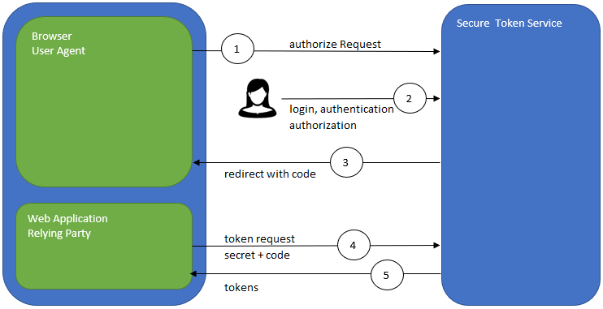
OIDC Authorization Code flow
Notes:
The Authorization Code Flow returns an Authorization Code to the Client, which can then exchange it for an ID Token and an Access Token directly. This provides the benefit of not exposing any tokens to the User Agent and possibly other malicious applications with access to the User Agent. The Authorization Server can also authenticate the Client before exchanging the Authorization Code for an Access Token. The Authorization Code flow is suitable for Clients that can securely maintain a Client Secret between themselves and the Authorization Server.
Steps:
Client prepares an Authentication Request containing the desired request parameters.
Client sends the request to the Authorization Server.
Authorization Server Authenticates the End-User.
Authorization Server obtains End-User Consent/Authorization.
Authorization Server sends the End-User back to the Client with an Authorization Code.
Client requests a response using the Authorization Code at the Token Endpoint.
Client receives a response that contains an ID Token and Access Token in the response body.
Client validates the ID token and retrieves the End-User's Subject Identifier.

Slide 24
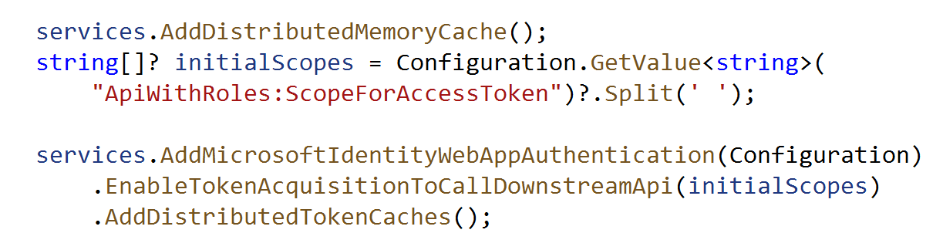
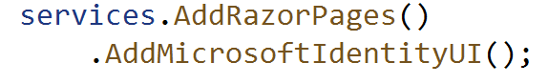
Microsoft.Identity.Web
https://github.com/damienbod/AzureADAuthRazorUiServiceApiCertificate
Notes:
https://github.com/AzureAD/microsoft-identity-web

Slide 25
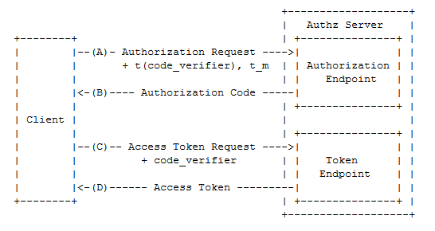

Slide 26
Microsoft.Identity.Web
https://github.com/AzureAD/microsoft-identity-web

Slide 27
Authorization with no users
Notes:
Explain one stop apps, reusing company AAA

Slide 28
Microsoft Identity authentication with no users
Only TRUSTED applications can do this.

Slide 29
No users http://openid.net/specs/openid-connect-core-1_0.html
OAuth2 Resource Owner Credentials Flow
Azure Managed Identities
On Behalf Of (OBO) Flow
Notes:
15 mins
Protected, trusted applications question

Slide 30
OAuth2 Resource Owner Credentials Flow
MC to MC applications
trusted client
grant_type=client_credential&client_id=xxxxxxxxxx&client_secret=xxxxxxxxxx
Limited user cases

Slide 31
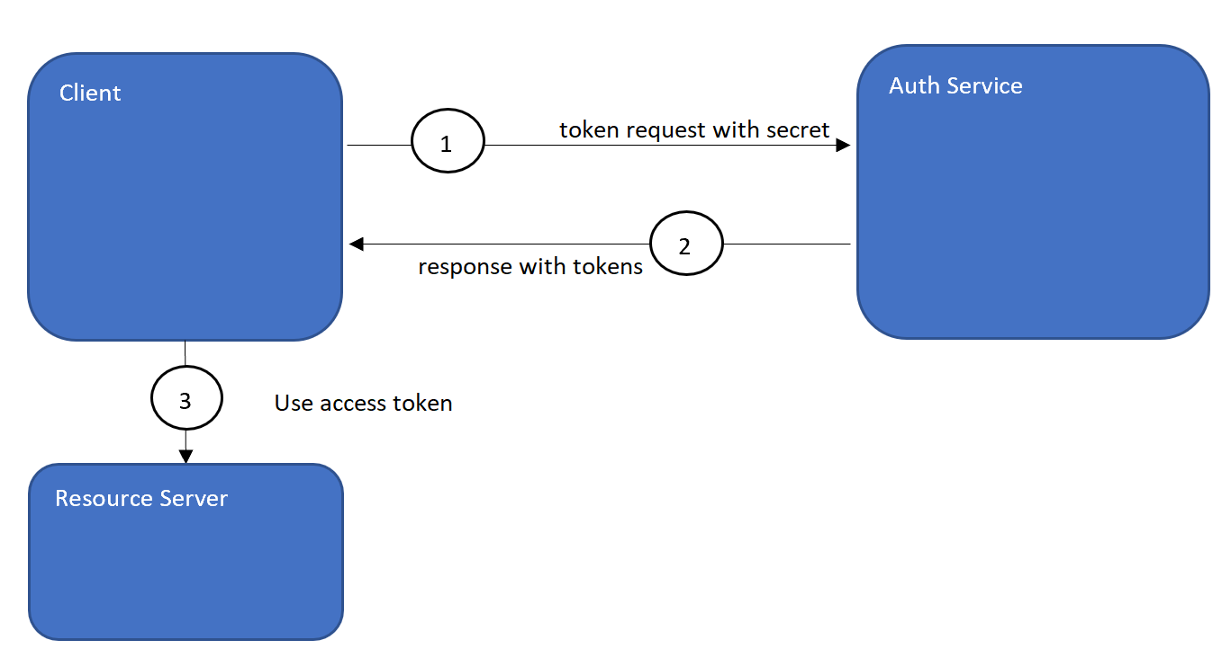
OAuth2 Resource Owner Credentials Flow

Slide 32
Microsoft.Identity.Client
https://github.com/AzureAD/microsoft-authentication-library-for-dotnet

Slide 33
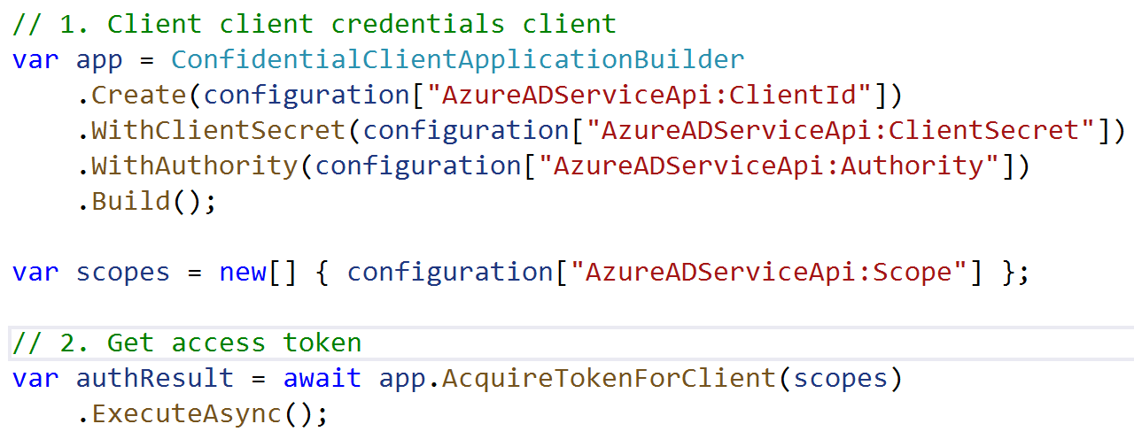
Microsoft.Identity.Client
"Scope": "api://--clientId--/.default"
https://github.com/damienbod/AzureADAuthRazorUiServiceApiCertificate

Slide 34

Azure Managed identities
Service to service
Service assigned Managed Identity
User assigned Managed Identity
Is a service principal or built using SPs

Slide 35
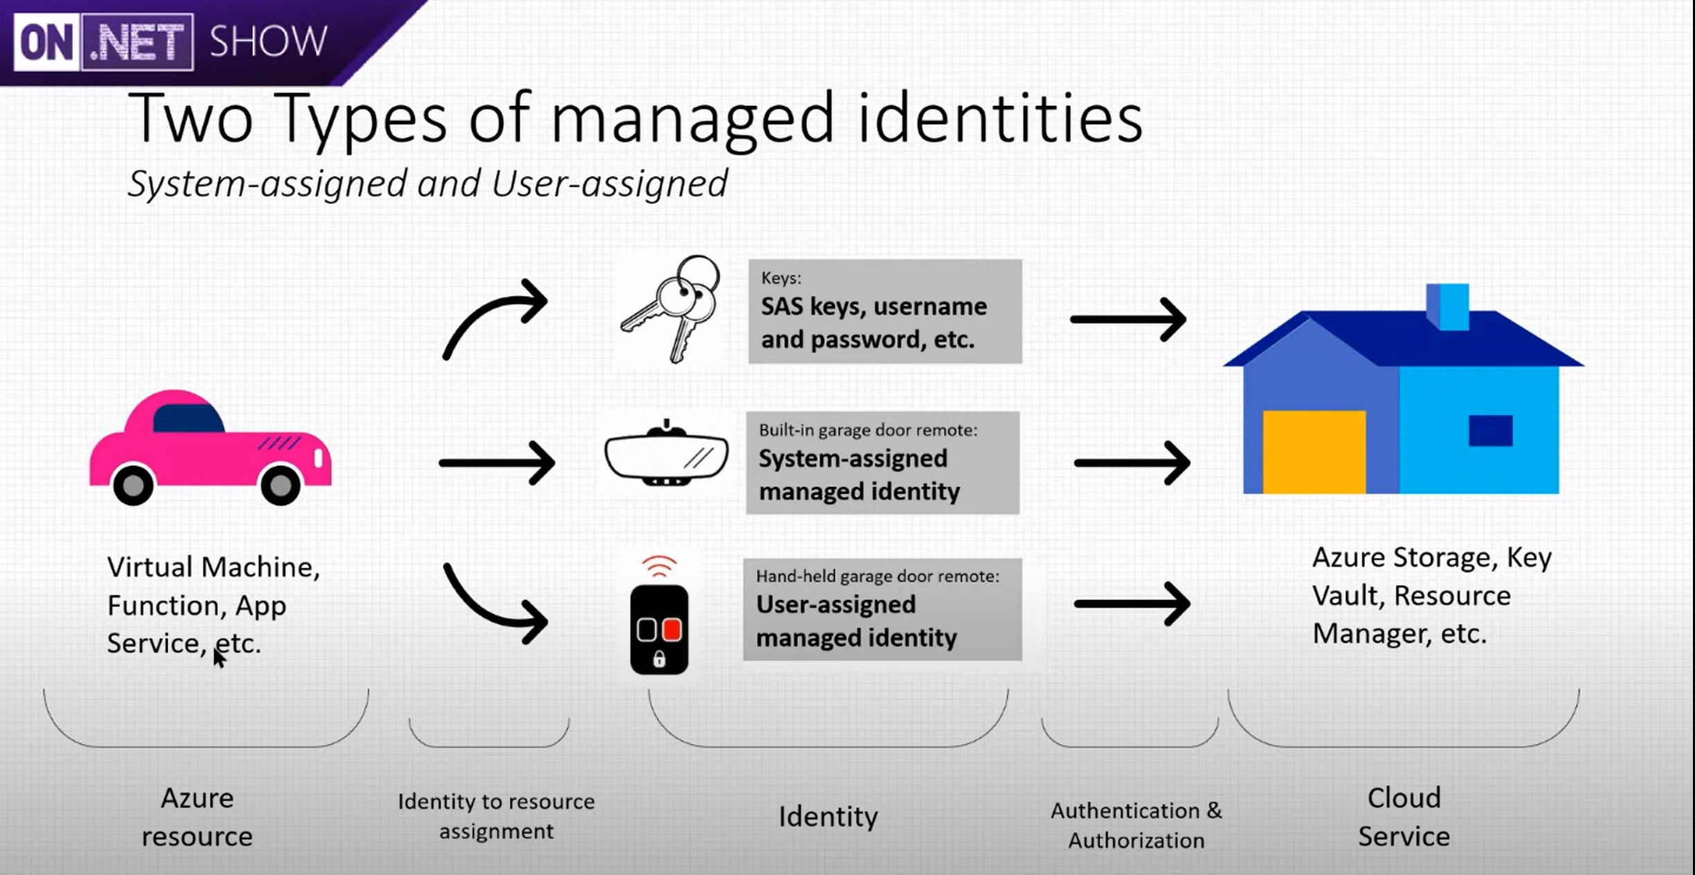
src: https://www.youtube.com/watch?v=vYUKC0mZFqI

Slide 36
OAuth On Behalf of OBO Flow
- RFC 6749
https://tools.ietf.org/html/rfc6749
https://docs.microsoft.com/en-us/azure/active-directory/develop/v2-oauth2-on-behalf-of-flow

Slide 37
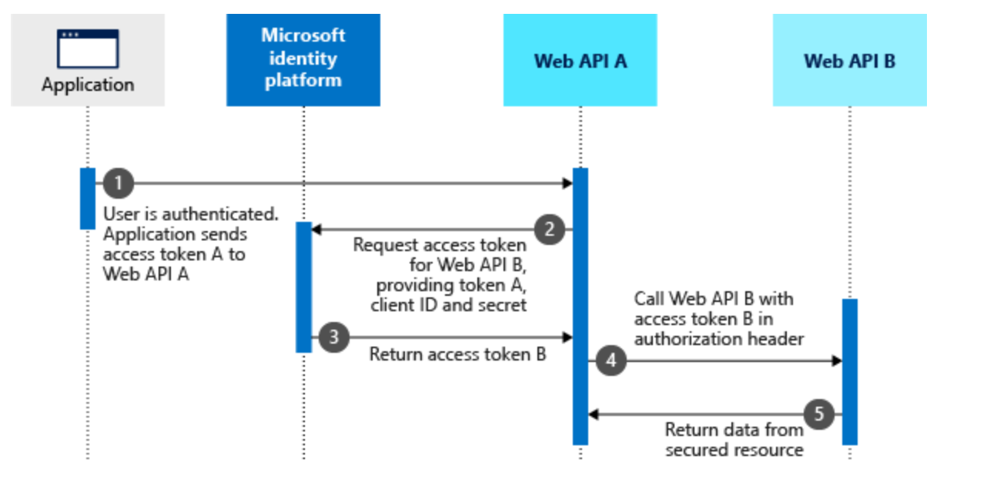
src: https://docs.microsoft.com/en-us/azure/active-directory/develop/v2-oauth2-on-behalf-of-flow

Slide 38
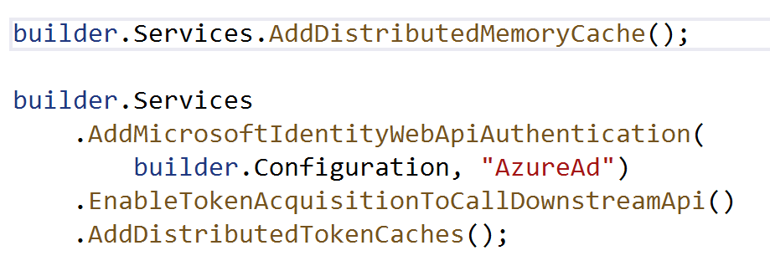
Microsoft.Identity.Web
https://github.com/damienbod/AzureADAuthRazorUiServiceApiCertificate

Slide 39
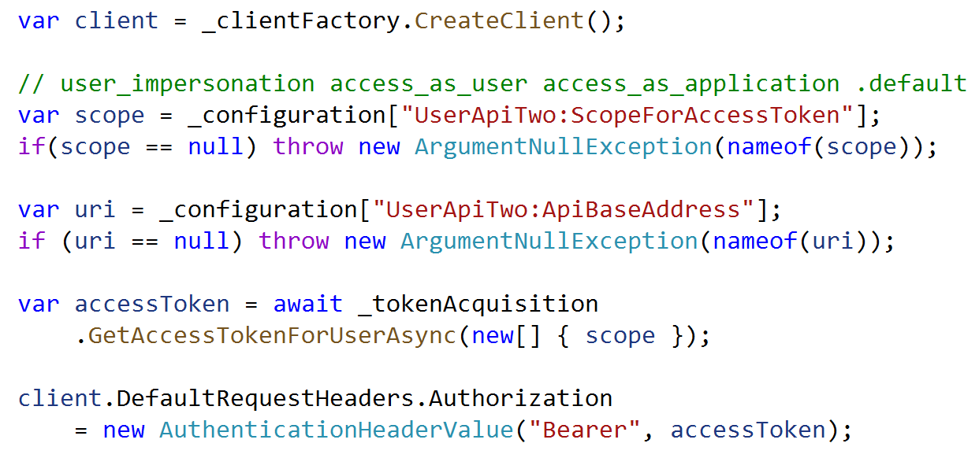
Microsoft.Identity.Web

Slide 40
Securing APIs
Notes:
Explain one stop apps, reusing company AAA

Slide 41
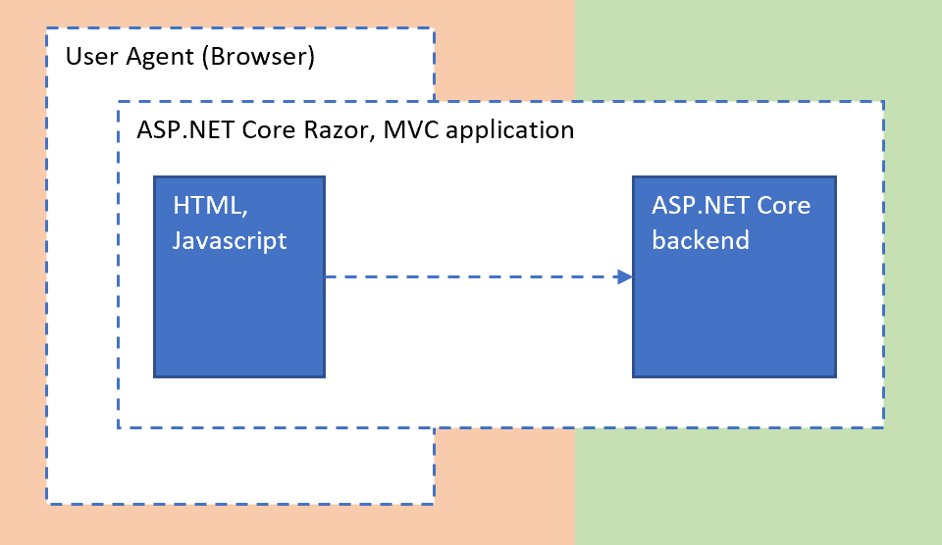

Slide 42
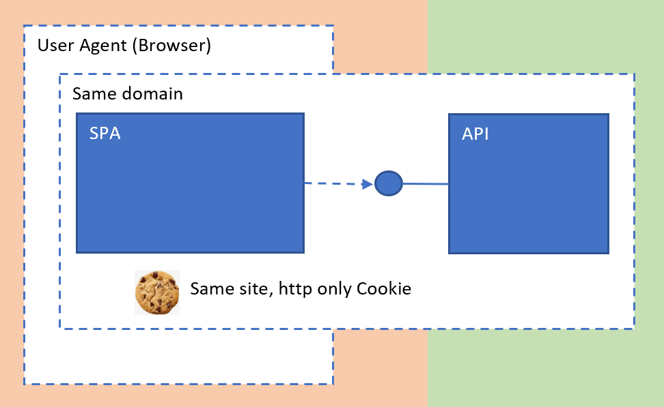

Slide 43
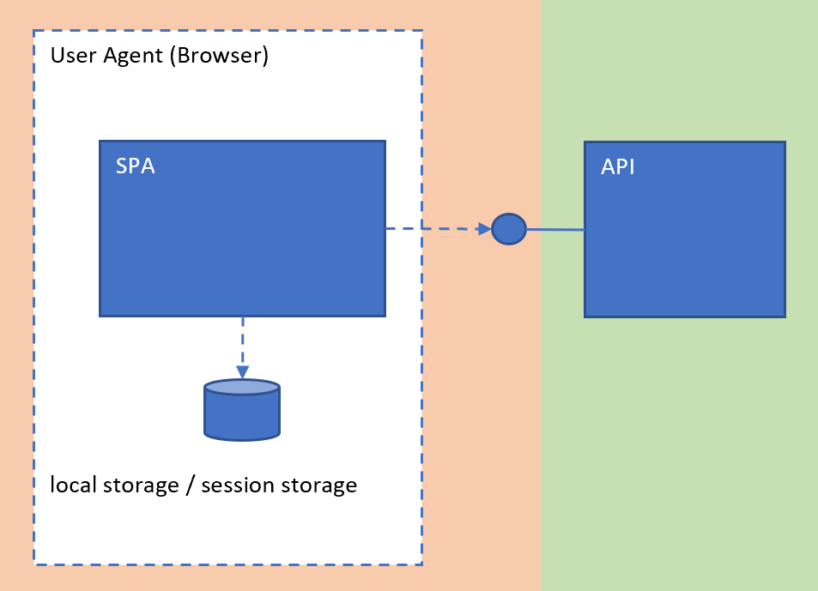
Notes:
New slide Problems with SPA apps ? What is a SPA?

Slide 44
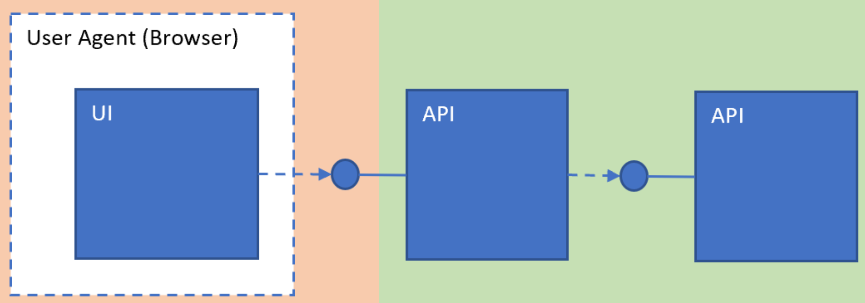

Slide 45
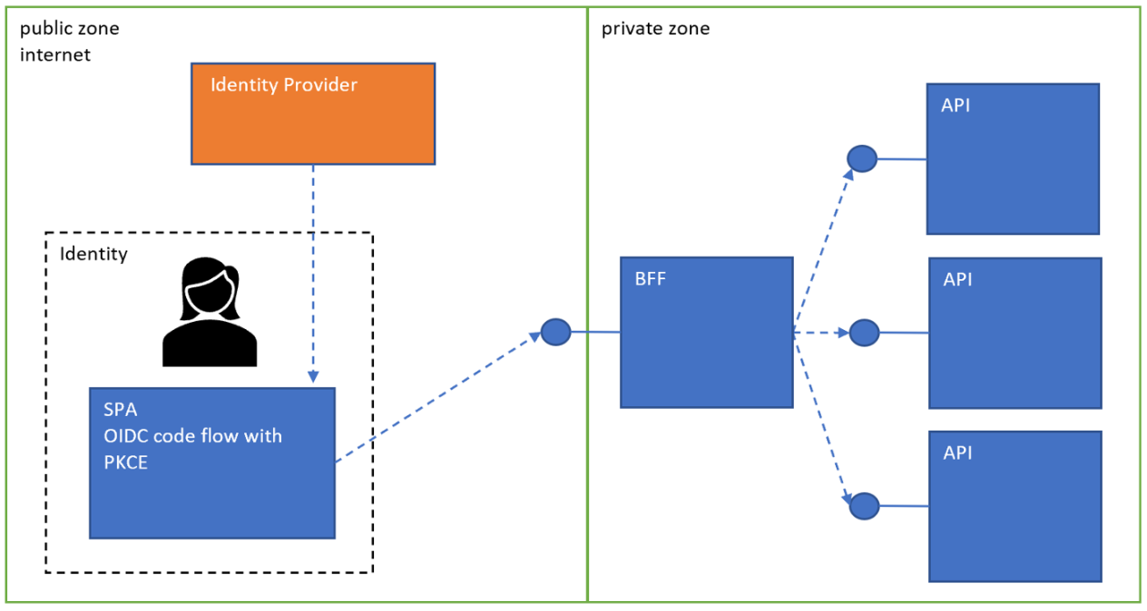

Slide 46
Azure continuous access & continuous access evaluation
Notes:
Explain one stop apps, reusing company AAA

Slide 47

Using conditional access
Create an authentication context using Graph or the Portal
1
Create a Conditional Access | Policies to use the context
2
Force the context in an application
3

Slide 48
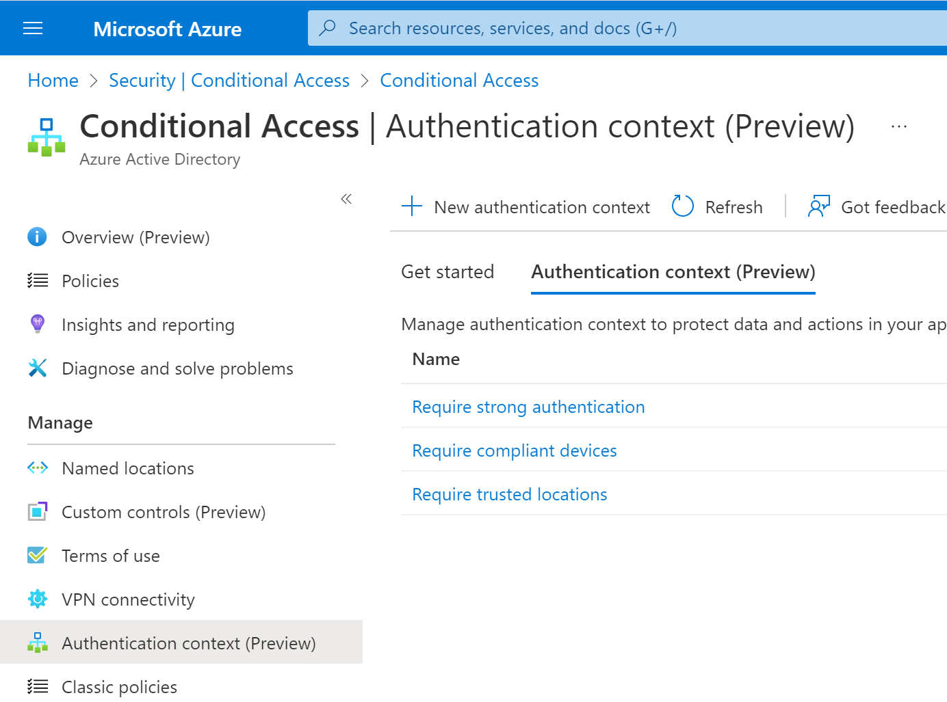

Slide 49
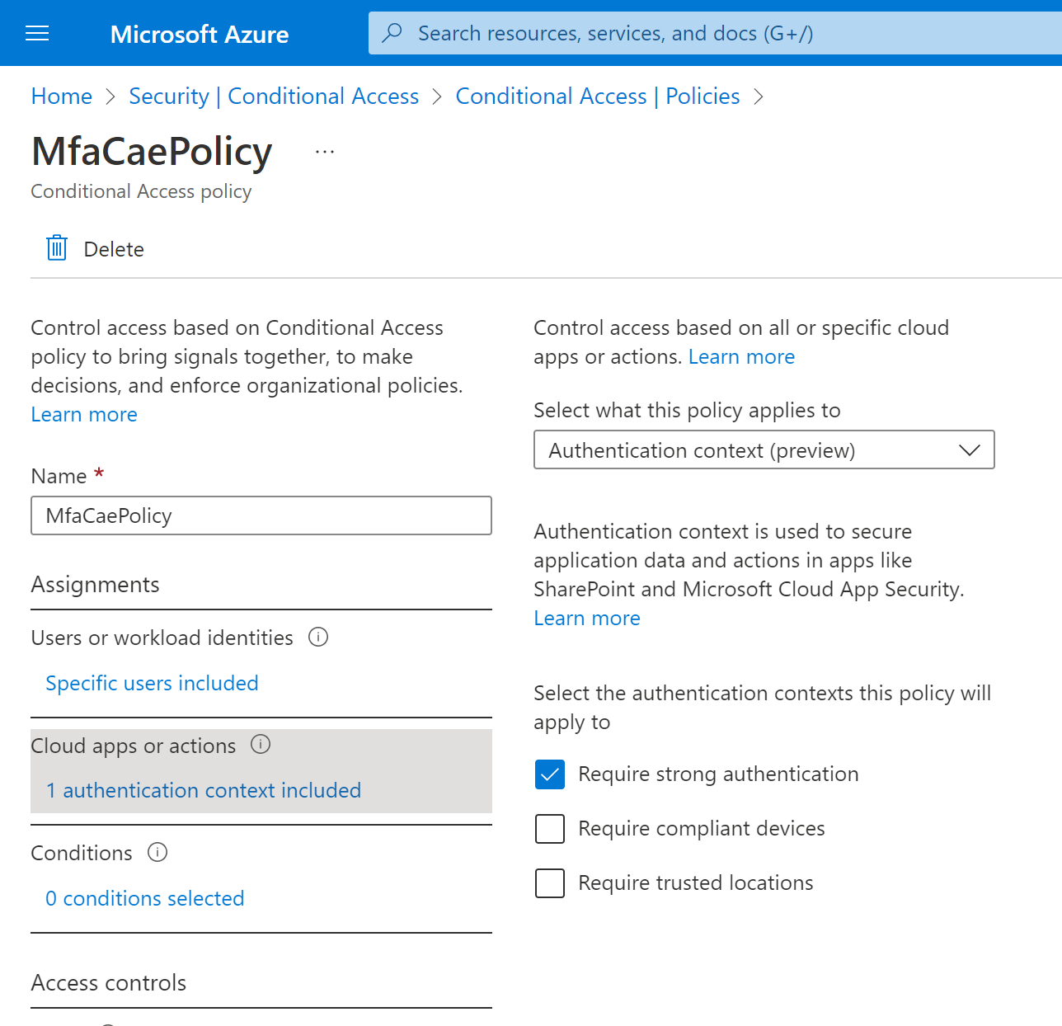

Slide 50
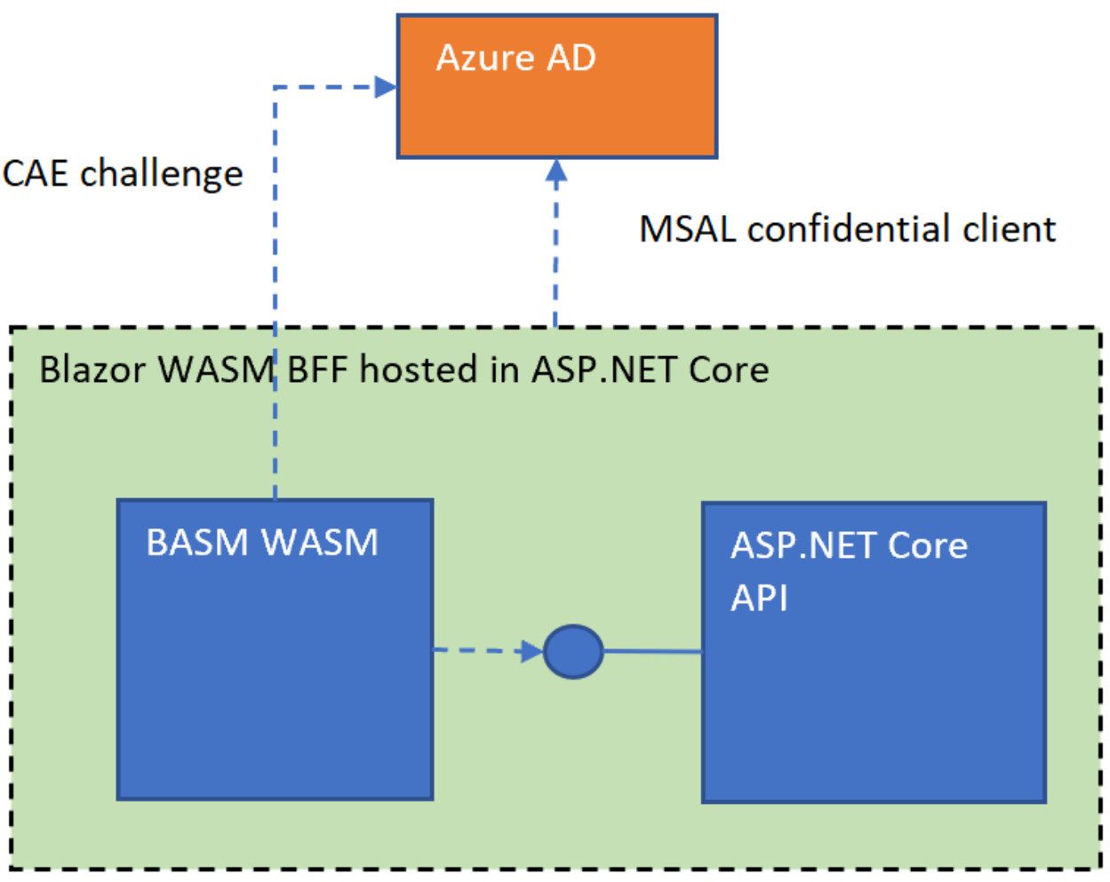
https://github.com/damienbod/AspNetCoreAzureADCAE

Slide 51
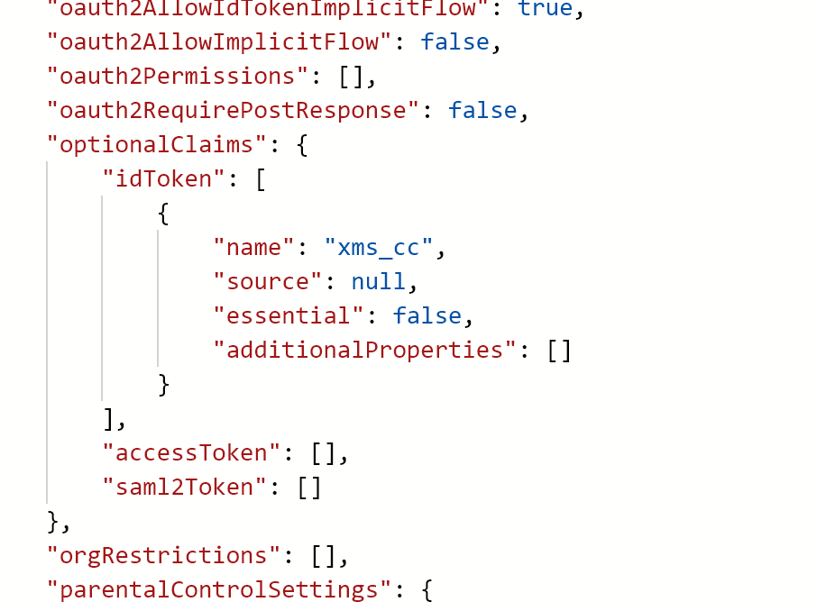

Slide 52
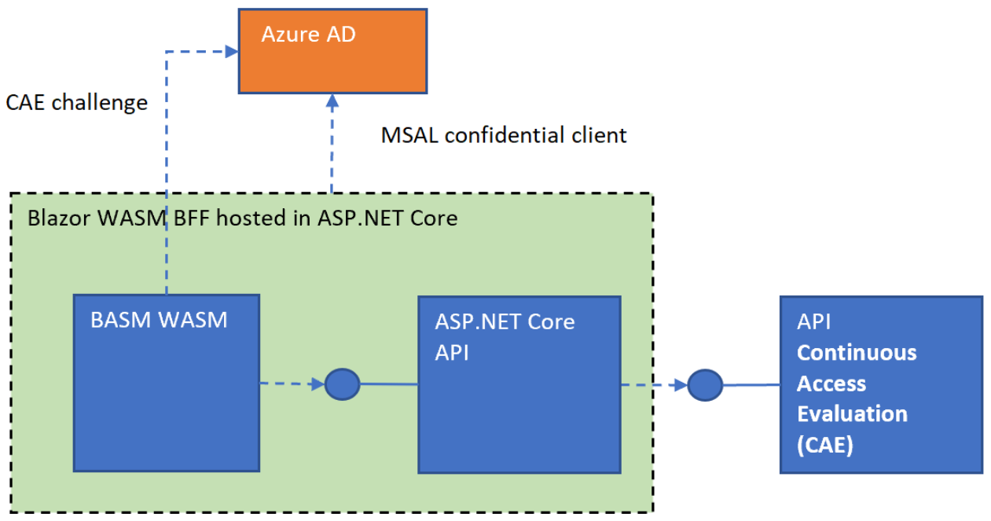
Notes:
https://github.com/damienbod/AspNetCoreAzureADCAE

Slide 53
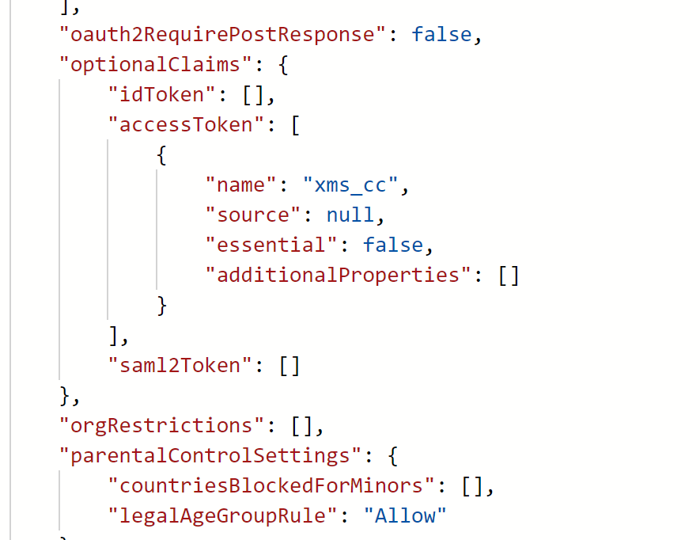

Slide 54
What about continuous access evaluation?
CAE setup in Azure Active Directory

Slide 55













